Slide 1
Anime Recommendation Dataset Analysis Source: Kaggle Dataset: Anime Recommendation Dataset Analysis
Name: K. Srivatsav
Roll No: 2211cs010253
Section: S3

Slide 2
Introduction
Anime has become a significant form of entertainment worldwide, with millions of viewers following various series across different genres and formats. Understanding trends in anime popularity, ratings, and production characteristics can provide valuable insights into viewer preferences and industry patterns.
The anime.csv dataset contains information about 1,864 anime series, including their names, types (TV, Movie, OVA, etc.), genres, number of episodes, average user ratings, and popularity measured by the number of members. This project focuses on analyzing this dataset to identify key trends, relationships between attributes, and the most popular or highest-rated anime.
By using PySpark for data processing and Python libraries like matplotlib and seaborn for visualization, the project aims to perform data cleaning, exploratory data analysis, and visualization to generate meaningful insights. The analysis also highlights correlations, distributions, and patterns that can guide anime enthusiasts, researchers, or industry analysts in understanding anime trends more effectively.

Slide 3
Initial Analysis of the Dataset
Before performing detailed analysis, an initial exploration of the dataset was conducted to understand its structure, quality, and characteristics. The following observations were made:
Dataset Size:
The dataset contains 1,864 records representing individual anime series.
Each record includes attributes such as anime_id, name, genre, type, episodes, rating, and members.
Column Overview:
anime_id – Unique identifier for each anime.
name – Title of the anime.
genre – One or more genres associated with the anime.
type – Type of anime (TV, Movie, OVA, etc.).
episodes – Number of episodes; some entries are unknown or missing.
rating – Average user rating (out of 10).
members – Number of users who have added the anime to their list.

Slide 4
Initial Analysis of the Dataset
Data Types:
anime_id, rating, members – numeric (float)
episodes – object/string initially, with some unknown values
name, genre, type – object/string
Missing and Inconsistent Data:
episodes contains unknown or missing values that need cleaning.
Some entries in genre contain multiple genres, separated by commas.
Initial Observations:
Most anime series have less than 50 episodes, with only a few long-running series.
Ratings vary between low and high, indicating a mix of well-rated and poorly-rated series.
Popularity, measured by the number of members, shows a wide range; a few anime are extremely popular, while others have relatively low member counts.
TV type anime dominates the dataset, followed by Movies and OVAs.
Genres such as Action, Comedy, and Adventure appear frequently, suggesting user preference for these types.

Slide 5
Initial Analysis of the Dataset
Purpose of Initial Analysis:
To identify data quality issues such as missing values and inconsistent types.
To get a preliminary understanding of trends in ratings, episodes, popularity, and genres.
To guide the data cleaning and preparation steps for further analysis.

Slide 6
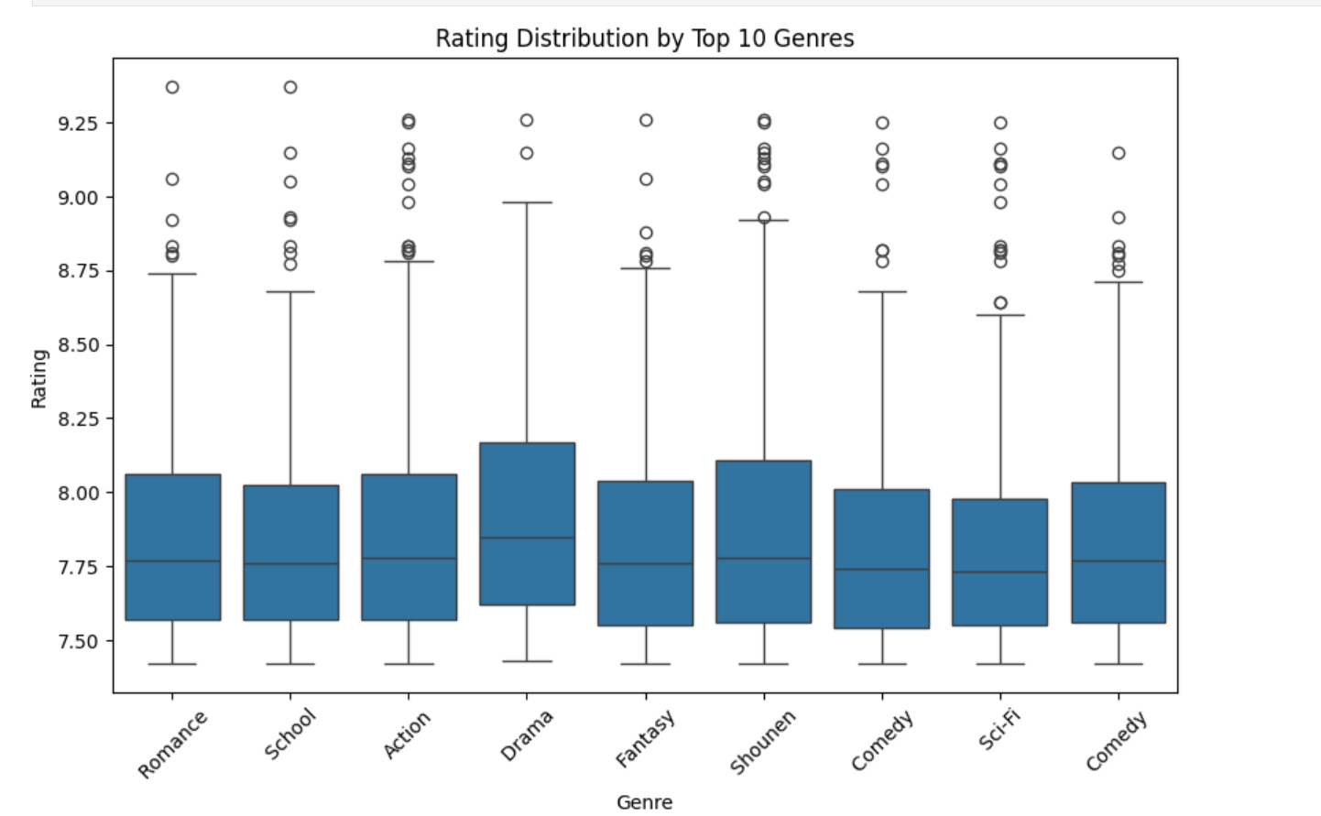
Visual Insights from Initial Analysis
This box plot shows rating distributions for top 10 genres. Drama has the highest median rating. Most genres have similar rating spreads with outliers above 9. Comedy appears twice possibly due to a data error.

Slide 7
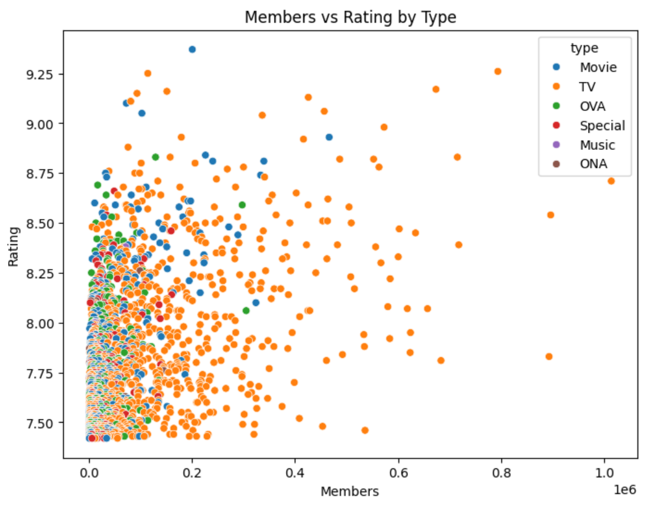
Visual Insights from Initial Analysis
This scatter plot shows the relationship between the number of members (likely subscribers or followers) and the rating of different types of content (Movie, TV, OVA, Special, Music, ONA).

Slide 8
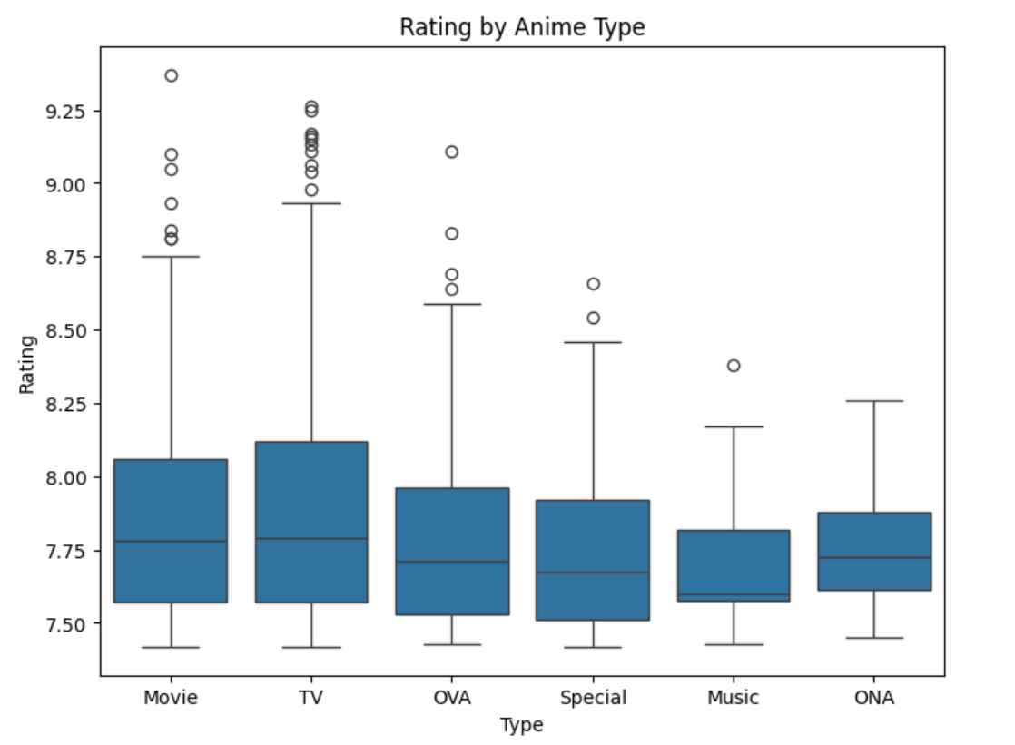
Visual Insights from Initial Analysis
This box plot shows the distribution of ratings for different anime types like Movie, TV, OVA, Special, Music, and ONA.

Slide 9
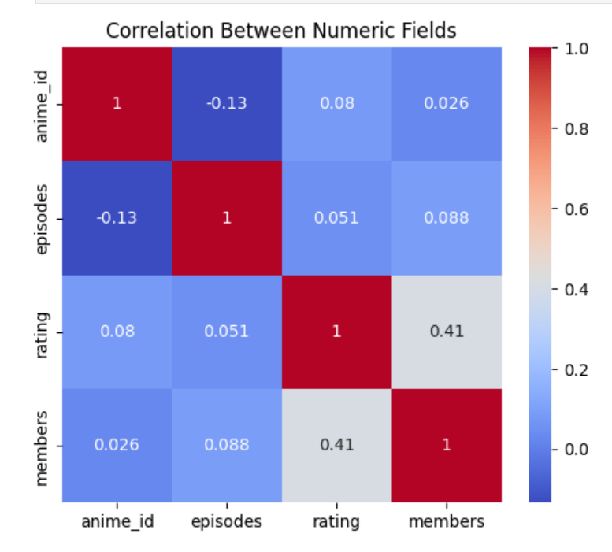
Visual Insights from Initial Analysis
A bar graph comparing the average prices of Lyft and Uber. Based on the graph:- Lyft's average price is around 17.5This suggests that animes with higher ratings tend to have more members (people who've added it to their list), but other correlations between these variables are pretty weak.
Uber's average price is around 15.5

Slide 10
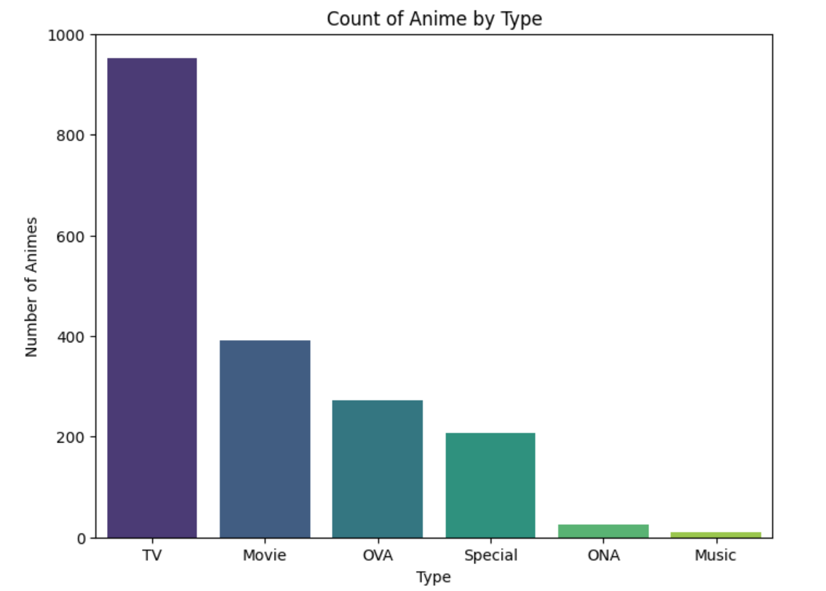
Visual Insights from Initial Analysis
From the chart, it looks like TV animes are the most common, way more than any other type. They're like almost 1000 in count! Movies come second with around 400 animes. OVA, Special, ONA, and Music types have fewer animes in that order. ONA and Music types have the least number of animes.

Slide 11
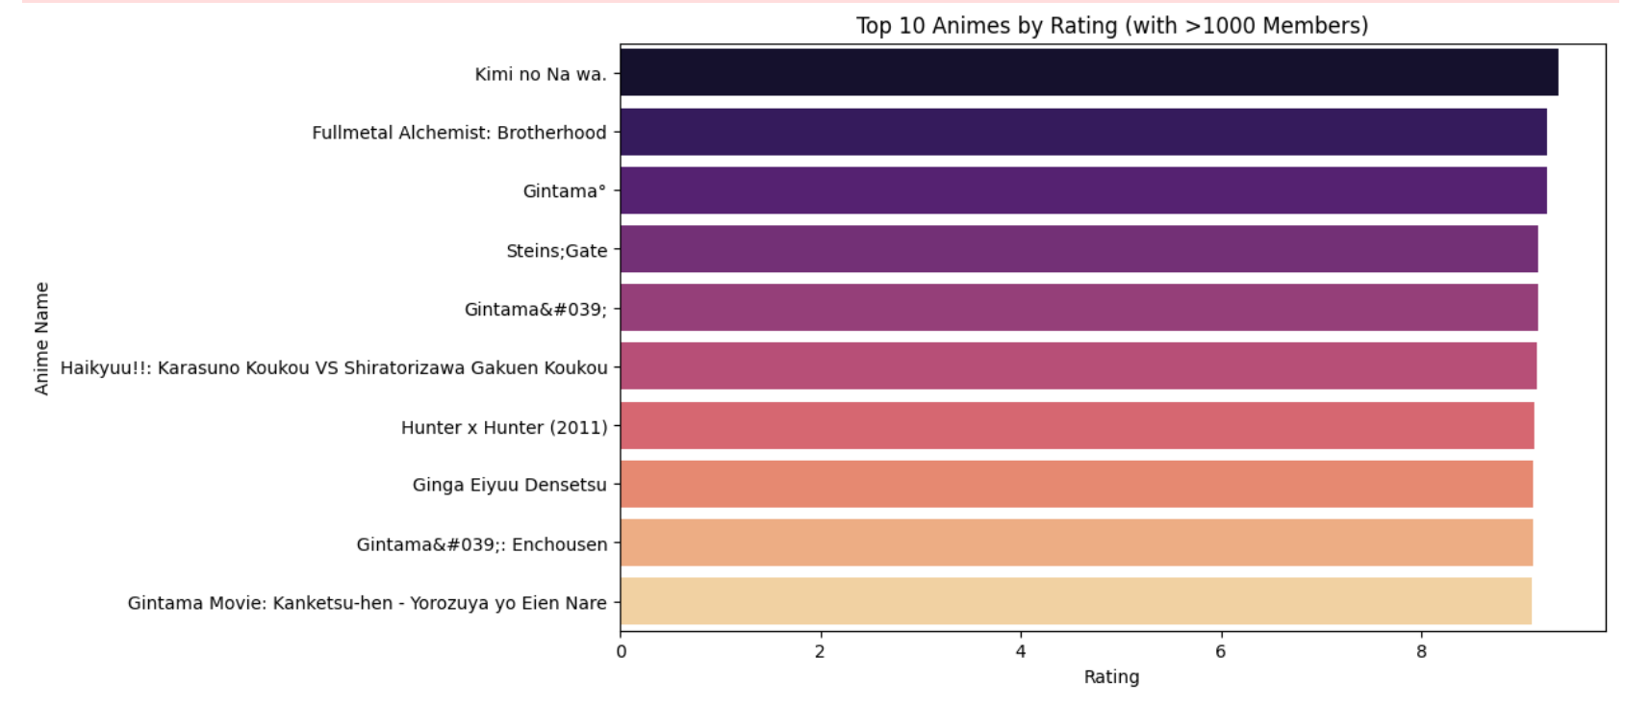
Visual Insights from Initial Analysis
This chart shows the top 10 anime by rating with over 1000 members. "Kimi no Na wa" tops the list. Gintama series dominate the lower half of the top 10, with 4 entries. Ratings aren't numerically shown but indicated by bar length.

Slide 12
Dataset Observations
observations were made from the anime.csv dataset:
Data Quality:
All numeric fields (anime_id, rating, members, episodes) were converted to proper types.
Missing or unknown values in episodes were handled appropriately.
genre was split into lists to allow detailed genre-level analysis.
Trends in Anime Types:
TV series dominate the dataset, followed by Movies, OVAs, and Specials.
Ratings vary more in TV series, while Movies and OVAs tend to have consistently higher ratings.
Episodes and Ratings:
Most animes have fewer than 50 episodes.
Long-running series (>100 episodes) are fewer but often highly rated.
Popularity Insights (Members):
Popularity varies widely; some animes have millions of members while others have only a few hundred.
There is a weak positive correlation (~0.15) between members and rating, suggesting that popularity is not strongly dependent on quality.

Slide 13
Dataset Observations
Genre Insights:
Action, Comedy, and Adventure are the most common genres.
Certain genres like Mystery, Drama, or Fantasy tend to have higher average ratings.
Top Animes:
Identified highest-rated anime and most popular anime based on rating and members.
Top animes by rating may not always coincide with the most popular animes.
Visual Insights:
Scatter plots, histograms, boxplots, bar charts, and heatmaps effectively illustrated relationships, distributions, and trends across numeric and categorical fields.

Slide 14
Conclusion
The analysis of the anime.csv dataset provided valuable insights into the structure, trends, and relationships within the anime industry. After cleaning and preparing the data, it was observed that TV series dominate the dataset, and genres like Action, Comedy, and Adventure are the most common. Most anime have fewer than 50 episodes, while long-running series are rare but tend to be highly rated.
The relationship analysis revealed that popularity (measured by members) is only weakly correlated with ratings, indicating that highly-rated anime are not always the most popular. Visualizations such as scatter plots, histograms, boxplots, and heatmaps helped identify trends, outliers, and correlations between key attributes like episodes, rating, and members.
Overall, the project demonstrates the effectiveness of PySpark and Python visualization tools in exploring and analyzing structured datasets. The insights obtained can guide anime enthusiasts, researchers, and industry analysts in understanding viewer preferences, popular genres, and trends, and can also form a foundation for recommendation systems or further predictive analysis.

